Slide 1
Keyword Spotting Datasets

Slide 2



What are we going to learn?
Collect and Preprocess Data
Design
and Train
Model
Evaluate, Optimize, Convert, Deploy
Make
Inferences
Micro
Challenges with Keyword Spotting
The Keyword Spotting ML Pipeline
Hands-on training of a Keyword Spotting Model
Notes:
The Wake Words ML Pipeline = Hands on example drive case study of how to map a TinyML application to the pipeline in light of the previous CONSTRAINTS (pre-processing, model, data, testing etc.)
Bridge: https://thenounproject.com/term/challenge/2484190/
Diagram: by Dhilan (prof-owned)
Colab Logo: by Brian (prof-owned)

Slide 3
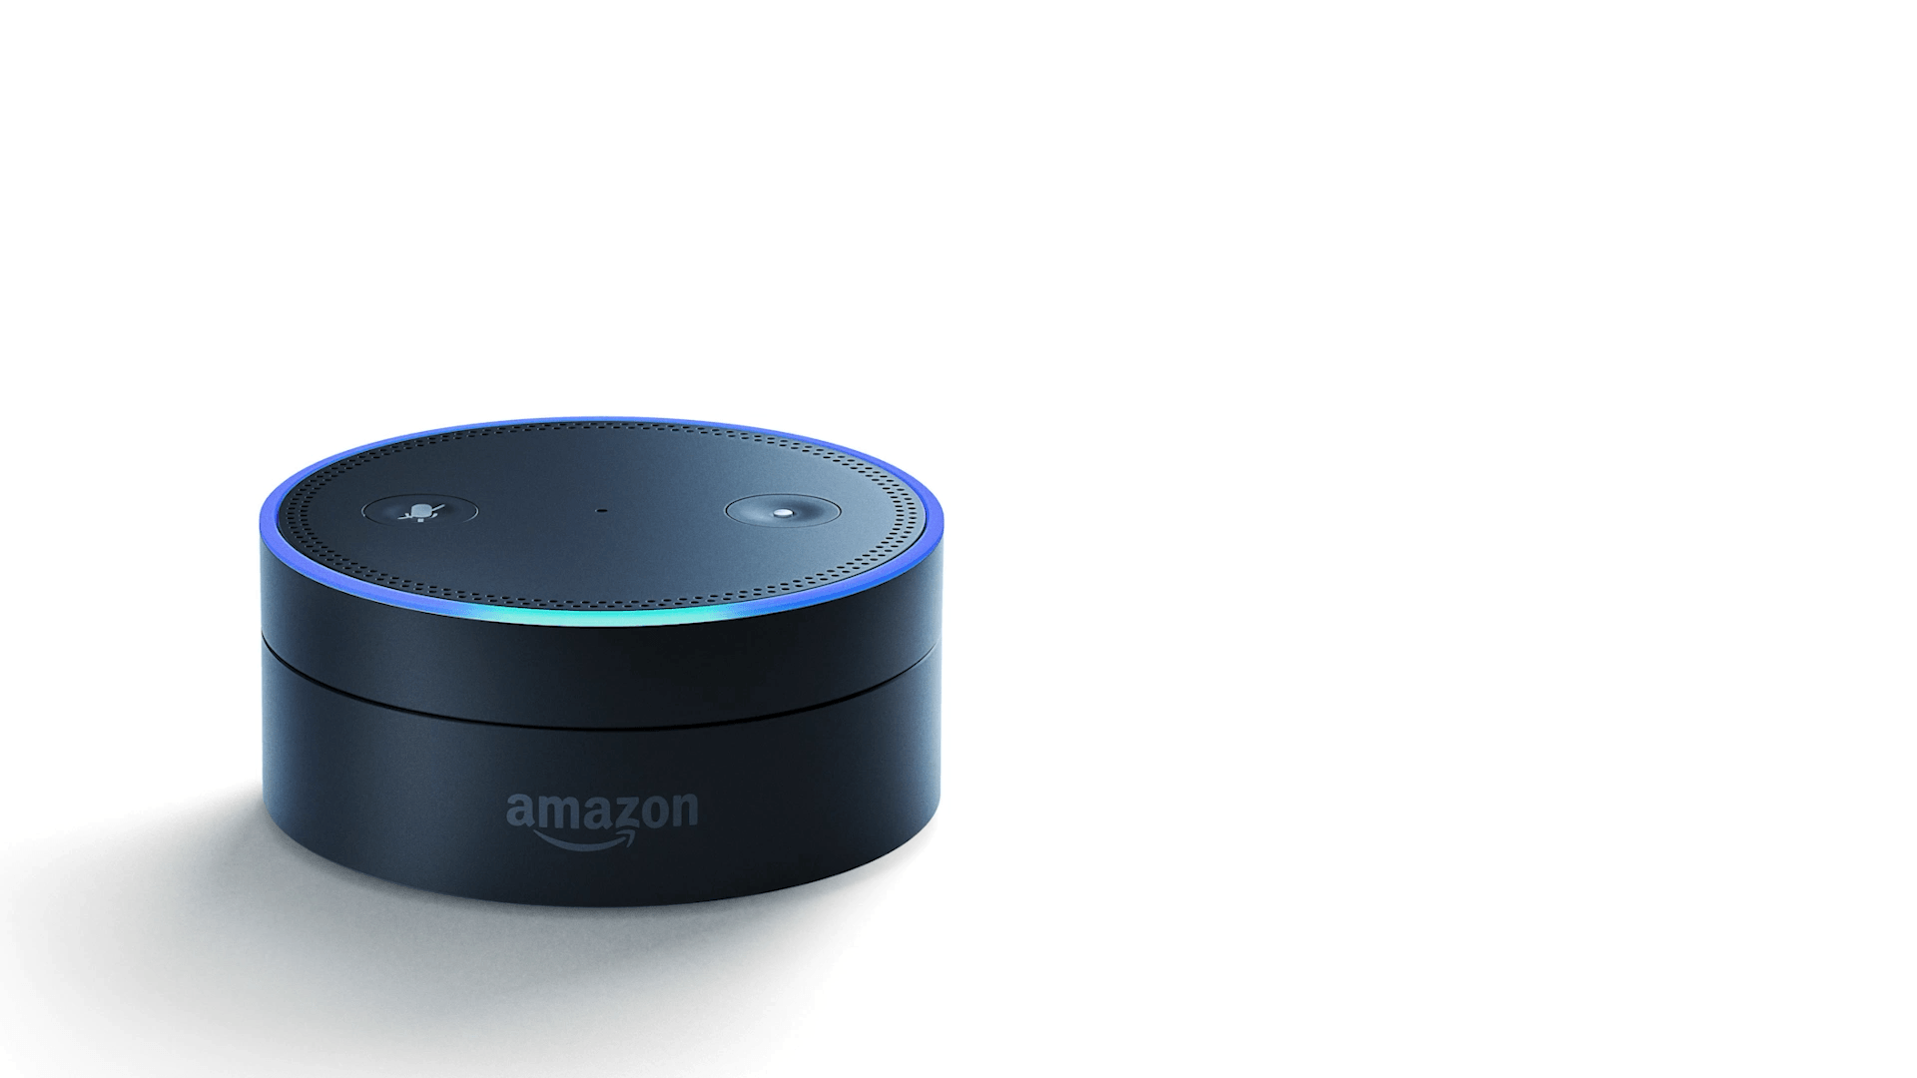
What does it mean to have a good dataset?
Notes:
IT CAN GENERALIZE -- it never heard you and it works!
How do we do that? Next slides
Notes:
What factors matter for something like “hey siri”
A voice assistant has never heard you before when you buy it from the store: how is that possible? You are a new example, and your environment is a new environment (it has never been tested before in your home or car etc…) and it just works: there must be something universal about speech (and data in general). next few modules: how to tackle this for any tinyml problem you are solving

Slide 4
So how do we build a good dataset?
Who are the users?

Slide 5
So how do we build a good dataset?
Who are the users?
What do they need?

Slide 6
So how do we build a good dataset?
Who are the users?
What do they need?
What task are they trying to solve?

Slide 7
So how do we build a good dataset?
Who are the users?
What do they need?
What task are they trying to solve?
How do they interact with the system?

Slide 8
So how do we build a good dataset?
Who are the users?
What do they need?
What task are they trying to solve?
How do they interact with the system?
How does the real world make this hard?

Slide 9
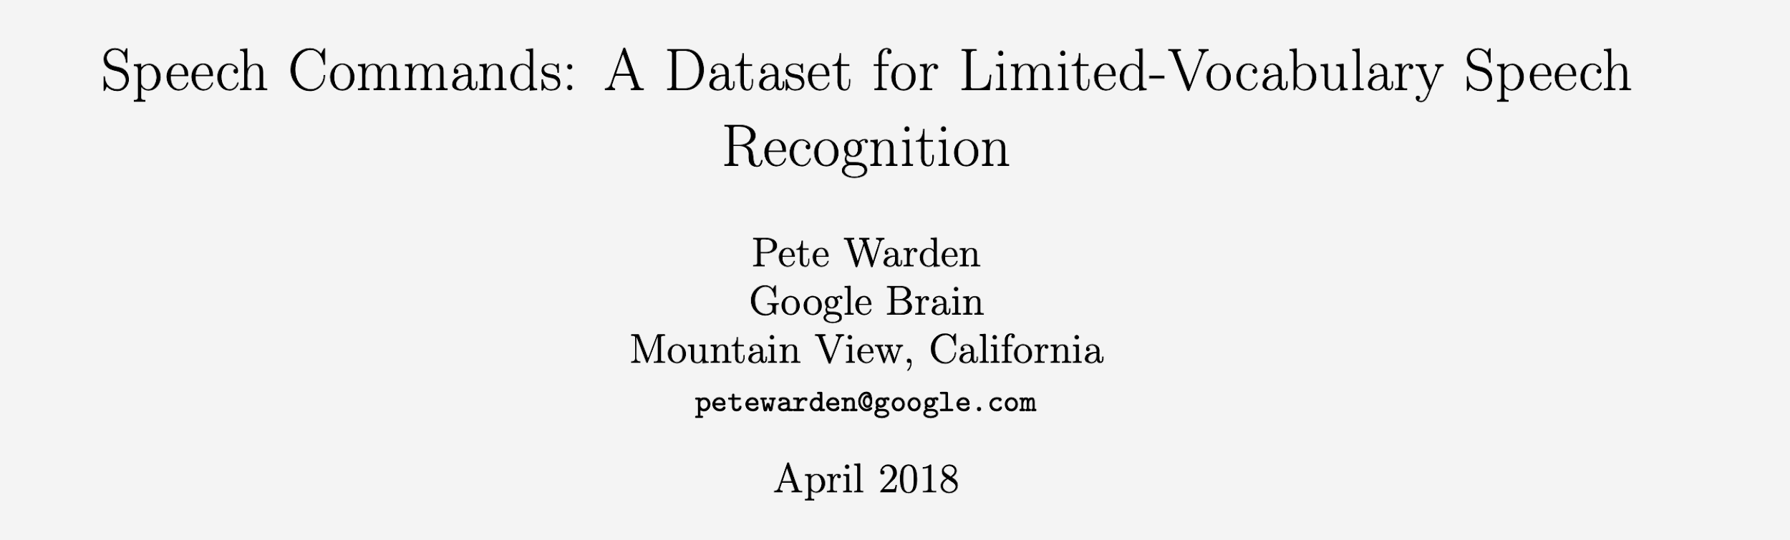
Notes:
We are using the OPEN SOURCE speech commands dataset designed by Pete @ Google. This dataset was designed to overcome limitations with existing publicly available datasets (google, apple, etc. have their production wake words datasets as proprietary)

Slide 10
The Speech Commands Dataset
Recorded as individual words not sentences
Notes:
→ overcame the alignment issue with other databases at the time (algined at word level vs. sentence level)

Slide 11
The Speech Commands Dataset
Recorded as individual words not sentences
1000-4000 examples of each word
Notes:
→ collected with sufficiently large scale to be effective however still limited by the number / diversity of volunteers but/and a good first pass at an open source dataset

Slide 12
The Speech Commands Dataset
Recorded as individual words not sentences
1000-4000 examples of each word
>2,500 volunteers
Notes:
→ collected with sufficiently large scale to be effective however still limited by the number / diversity of volunteers but/and a good first pass at an open source dataset

Slide 13
The Speech Commands Dataset
Recorded as individual words not sentences
1000-4000 examples of each word
>2,500 volunteers
Representative of real world audio and includes background noise as well
Notes:
→ collected with sufficiently large scale to be effective however still limited by the number / diversity of volunteers but/and a good first pass at an open source dataset

Slide 14
The Speech Commands Dataset
Recorded as individual words not sentences
1000-4000 examples of each word
>2,500 volunteers
Representative of real world audio and includes background noise as well
25 “IoT keywords” + 10 “unknown words” (with phonetic similarities: “three” vs “tree”)
Notes:
→ to overcome this lack of large numbers of volunteers and to provide an effective initial benchmark the dataset is limited to only 25 keywords in english but/and this is enough to start to test algorithms and applications
→ it also includes 10 other words that are similar to the keywords and cover other english sounds which is crucial otherwise the model might learn to recognize some talking at all vs. the particular words we care about

Slide 15
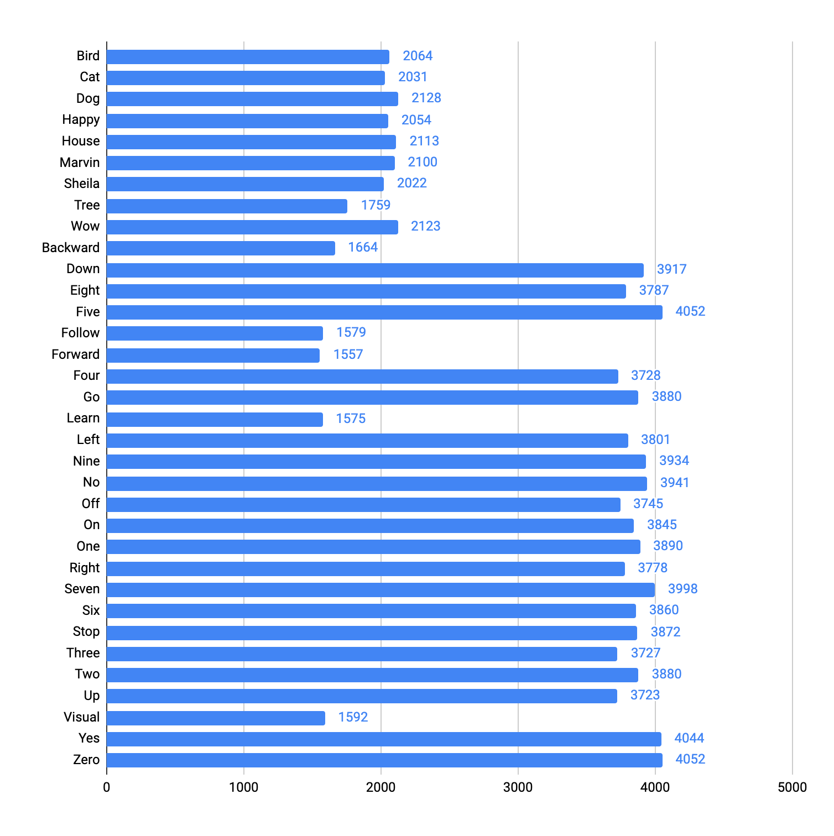
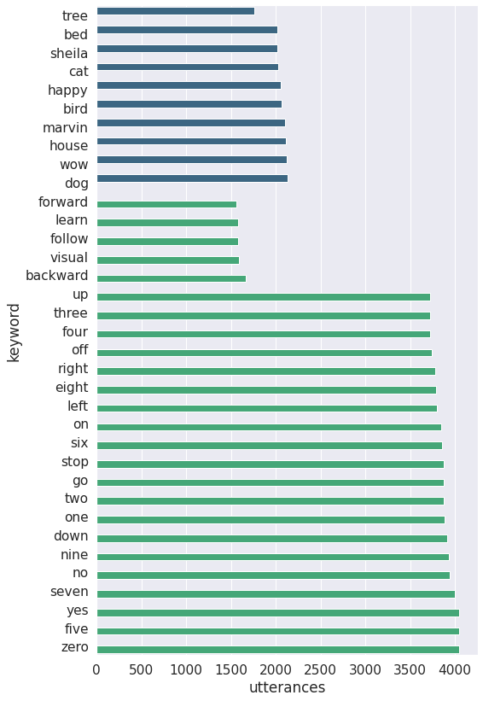
keyword
utterances
Notes:
Sure, here's the data: https://docs.google.com/spreadsheets/d/1fkcWqaUhS1-OcR_T98KgpcKpfA8Z3qIt8pohNguF9yU/edit?usp=sharing let me know if this works for you

Slide 16
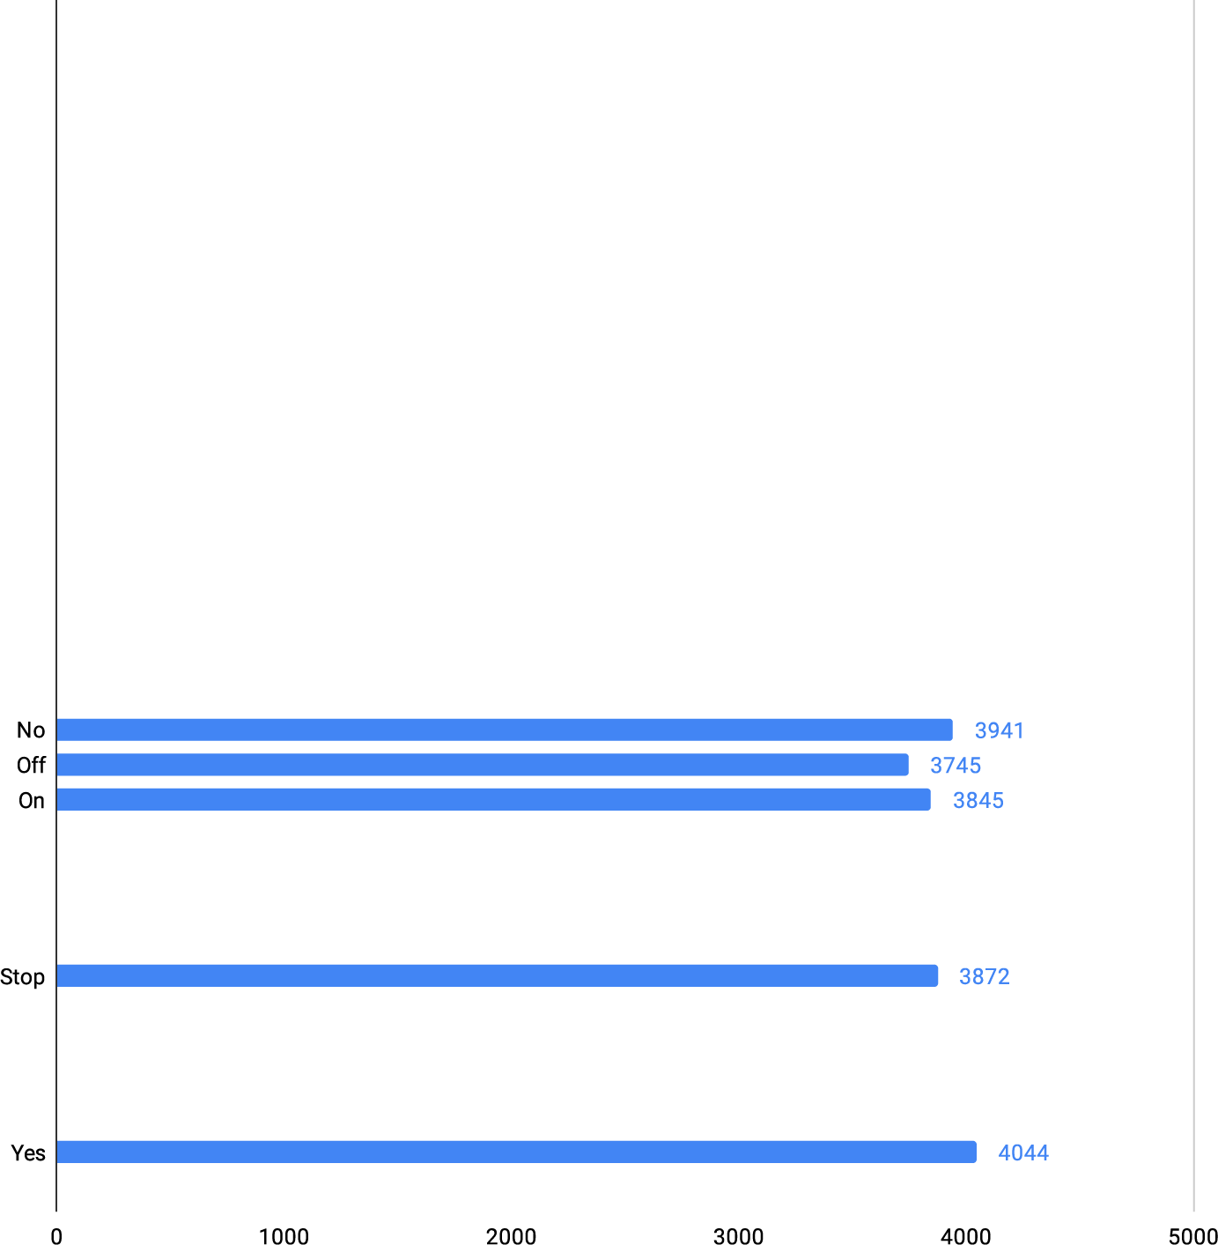
keyword
utterances
Notes:
Sure, here's the data: https://docs.google.com/spreadsheets/d/1fkcWqaUhS1-OcR_T98KgpcKpfA8Z3qIt8pohNguF9yU/edit?usp=sharing let me know if this works for you

Slide 17
Food for Thought
QC (Quality Control)
Need to keep only what a human can hear
Microphone issues
Noisy backgrounds
(more on this soon)

Slide 18
Notes:
Note that we will dive deeper into dataset collection and the challenges of collecting good UNBIASED datasets in the next section (and give you a chance to contribute back to the open source community!) and you’ll get a chance to collect your own custom dataset in course 3 -- but for now we will continue working through the ML flow for keyword spotting

